Slide 1
COLLEGE ASSIGNMENT TRACKER
Project Report Presentation

Slide 2
Student Details
STUDENT NAME : ASFAR BANU.M.B
YEAR : III
COLLEGE CODE : 403
COLLEGE NAME : DEEN COLLEGE OF ARTS AND SCIENCE
DEPARTMENT : BCA
SEMESTER : V-SEMESTER
ROLL NO : 24134130500122005
NMID : asanm41341324213005
GITHUB LINK :
https://github.com/dcca24asfar/Asfar.git

Slide 3
Abstract
College Assignment Tracker is a smart web application developed using HTML, CSS and JavaScript to help students manage assignments efficiently.

Slide 4
Problem Statement
Students forget deadlines and face difficulties in tracking assignments, submissions and pending works.

Slide 5
Objectives
• Assignment Management
• Status Monitoring
• Deadline Tracking
• Dashboard Analytics

Slide 6
Project Scope
The system manages assignments, displays statistics and improves student productivity.

Slide 7
Technologies Used
HTML
CSS
JavaScript
Browser Local Storage

Slide 8
Application Flow
User enters details → adds assignment → monitors status → deletes completed records.

Slide 9
HTML Structure
index.html provides forms, dashboard cards and tables.

Slide 10
CSS Design
style.css provides responsive layout, colors, cards and attractive UI.

Slide 11
JavaScript Functionality
script.js performs adding, deleting and dashboard calculations.

Slide 12
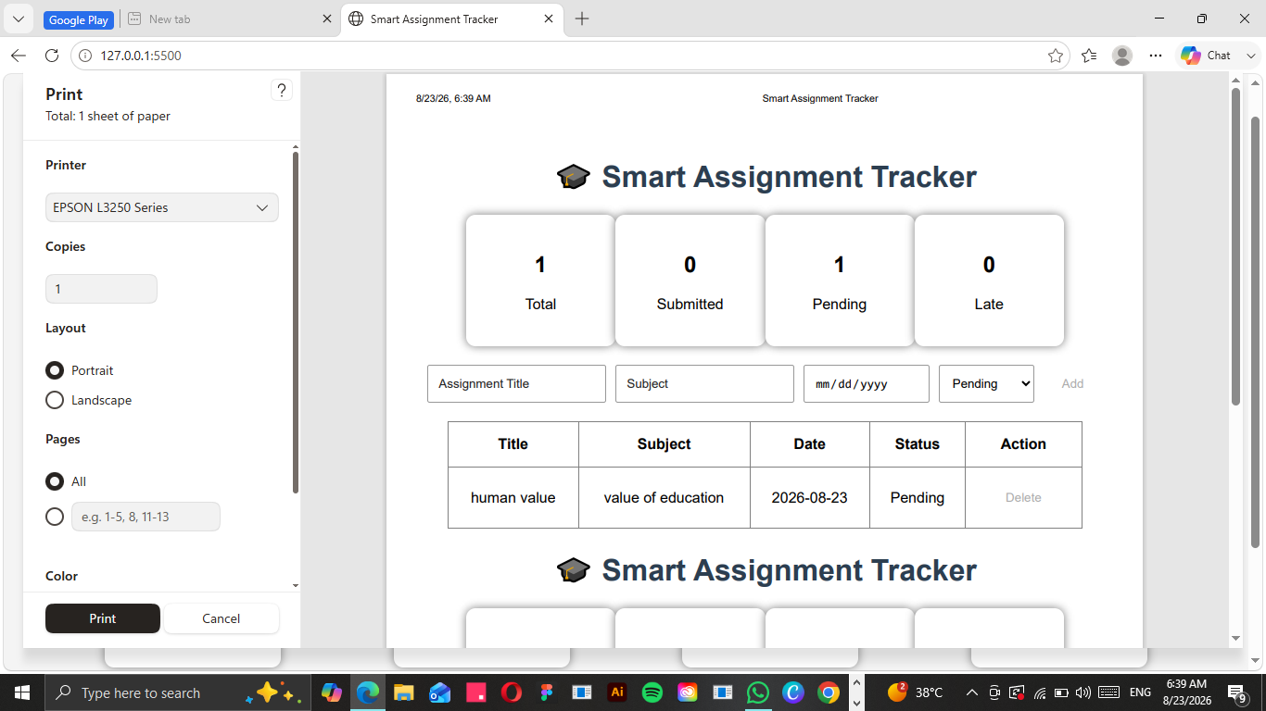
Project Output - Dashboard

Slide 13
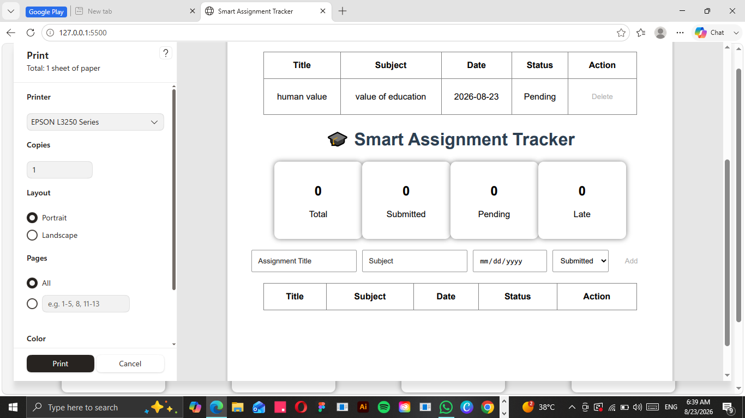
Project Output - Result

Slide 14
Challenges Faced
Responsive design issues, data management and dashboard calculations were solved successfully.

Slide 15
Learning Outcomes
Improved HTML, CSS, JavaScript, UI design and project development skills.

Slide 16
Conclusion
The College Assignment Tracker successfully helps students monitor assignments and improve productivity.

Slide 17
THANK YOU
ASFAR BANU.M.B
BCA - V SEMESTER

